Slide 1
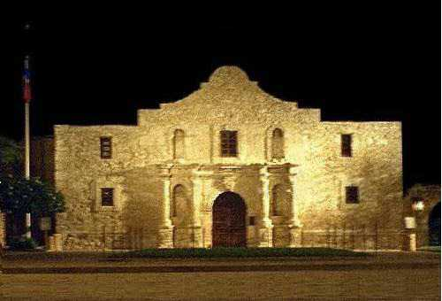
Chapter 12
Westward Expansion

Slide 2
The Texas Question
Following the Treaty of 1819, the region known as Texas was considered part of America
  Americans began moving into the region to settle
  Many brought slavery with them
At the same time, Mexico had thrown off Spanish rule and won its independence
  Mexicans were receptive to encroaching Americans

Slide 3
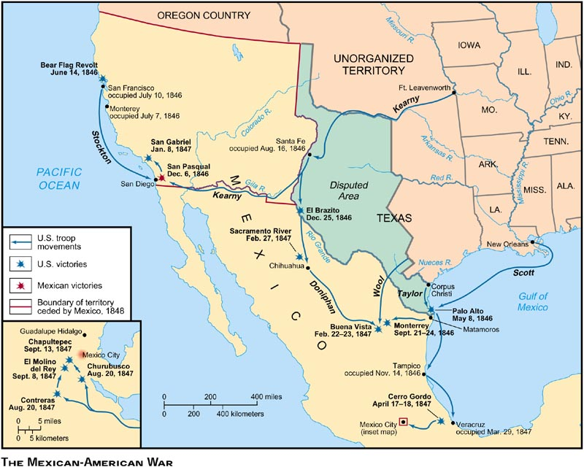

Slide 4
Texas
Mexico allowed Americans autonomy
  By 1830 there were many thousand more Americans than Mexicans in the region
Mexico began restricting American operations
  Americans felt that these restrictions were an injustice
  Small skirmishes broke out throughout the territory

Slide 5
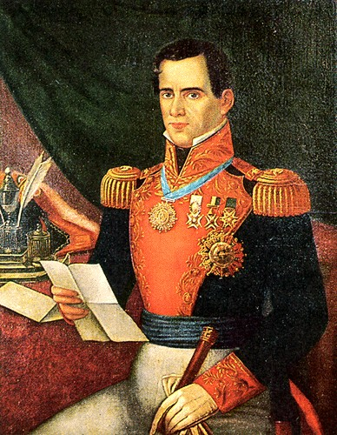
Antonio Lopez de Santa Anna
Mexican President
Marched 6,000 soldiers North to quell the rebellious Texans
Marched with the intention of attaching San Antonio

Slide 6
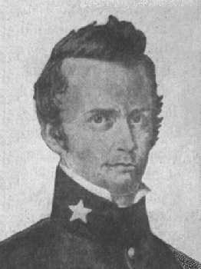
William B. Travis
Defended San Antonio from the Mexican Army
Commanded 187 Men
Utilized an aging Mission to protect his men

Slide 7
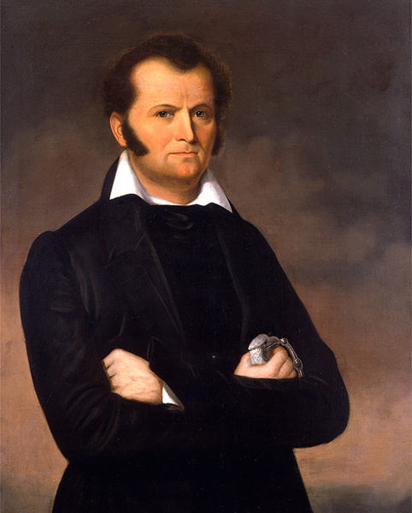
Jim Bowie
Brought a garrison of men to help support the Alamo
Would act as co-commander
Famous for his history of knife fighting

Slide 8
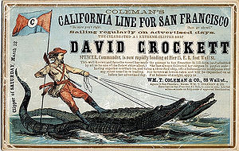
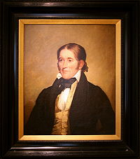
Davy Crockett
A national celebrity
Famous for his exploits on the frontier
Ventured to the Alamo as a way of proving himself still worthy of his fame

Slide 9
The Battle of the Alamo
Santa Anna’s men suffered heavy casualties
The Texans held off the force for 13 days
The Mexicans would take the fort
Once inside, all men were killed
  Crockett, Bowie, and Travis killed
  Wounded killed
The brave showing would act as a symbol for all of Texas’ history

Slide 10
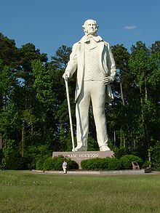
Sam Houston
Congressman in Tennessee, former soldier
Led the new army of Texas
Defeated Santa Anna at the Battle of San Jacinto
Became Texas’ first president

Slide 11
The Republic of Texas
The new Republic would be recognized by most European powers
Andrew Jackson would not consider allowing it to enter the United States
  Most Texans supported Annexation
Texas enjoyed an open relationship with Great Britain
  Many Southerners feared a relationship with GB would lead to the abolition of slavery in Texas

Slide 12
Would Texas become a state?
President Tyler supported Annexation
  Appointed Southerner John C. Calhoun as Secretary of State
Calhoun supported slavery
  Many Northerners were upset with his selection
  Many Northerners believed Annexation would lead to war with Mexico
Senate rejected Annexation

Slide 13
Manifest Destiny
The belief that America was meant to conquer the frontier
  America should expand all the way to the Pacific
Manifest Destiny was widely supported because:
  Growing Immigration
  Growing population

Slide 14
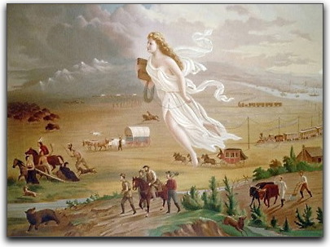

Slide 15
Manifest Destiny
Massive numbers of settlers began moving westward
  Life was difficult and harsh
Many dangers lurked on the journey
  Indian Violence
  Animal Attacks
  Harsh Weather
  Disease

Slide 16
Oregon and California
Many settlements soon developed in the Oregon Territory
  Accessed by using the Oregon Trail
The Oregon Territory became filled with American citizens building a new life

Slide 17
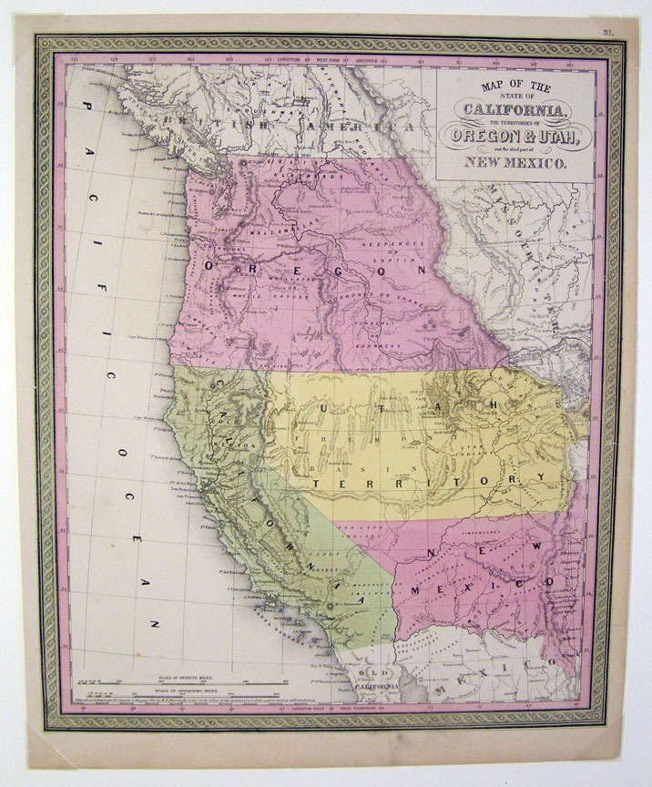

Slide 18
The Election of 1844
Henry Clay
  -Did not mention Texas in his platform
John C. Calhoun
  Opposed Annexation
Martin Van Buren
  Could not gain enough support
James K. Polk
  Thought of as a “Good Jacksonian”

Slide 19
Polk Wins
Polk openly supported Annexation
  Clay openly opposed it
Calhoun changed his mind of Annexation
  Lost many votes because of it
Polk wins majority to become President
  Petitioned Congress soon after victory to Annex Texas

Slide 20
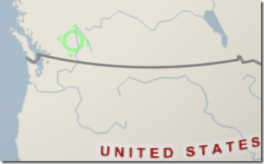
Polk as President
Oregon was Polk’s first order of business
  America and Great Britain enjoyed Joint Occupation in the region
  Claimed that America held a claim to the entire region in his inaugural address
  Also was willing to accept a boundary on the 49th Parallel.

Slide 21
“54-40 or Fight”
Polk offered this agreement to a British minister
  Richard Pakenham refused without consulting Parliament
In response, Polk now requested all of the territory
  As far north as the 54th parallel
  With no agreement, the joint occupation would end

Slide 22
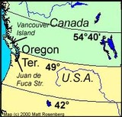

Slide 23
Britain Concedes
Britain bends at the threat of war
Britain asks for original agreement
  49th Parallel
  Treaty establishes that America owns everything from Rocky Mts. to Puget Sound
Northern Democrats call Tyler a traitor
  His refusal to fight for all of Oregon Territory

Slide 24
War with Mexico
Mexico owed a large sum of money to the U.S.
  Many suggested force be used to obtain in
U.S. settlers expanding into the Mexican territory caused tensions to grow
  Mexico broke off diplomatic relations upon the Annexation of Texas

Slide 25
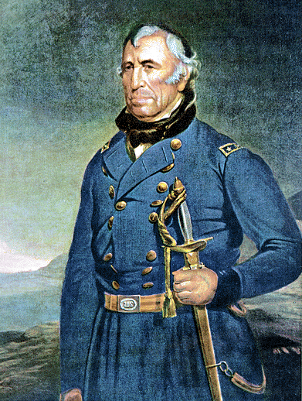
Polk Sends in “Old Rough n’ Ready”
President Polk sends a force to the Mexican border
  Led by General Zachary Taylor
  The border was soon found to
  be disputed

Slide 26
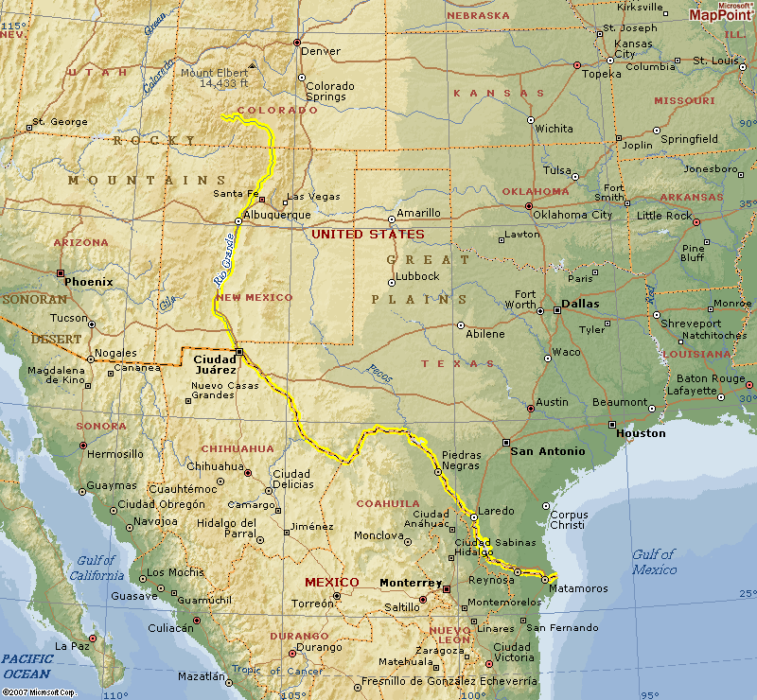
Border Wars
Texas claimed the U.S.-Mexican border was the Rio Grande
Mexico claimed it was the Nueces River

Slide 27
Mexico Respond
Mexico responded and pushed Taylor’s force back
Tyler petitioned Congress to declare war
The Battle of Palo Alto
  Taylor’s men push the Mexican Army across the Rio Grande
  The Rio Grande is now the Southern Border of Texas
    Only 50 Americans killed

Slide 28
Suspicions Abound
Northerners begin to suspect that if Mexico was conquered it would transform
  Slave States
The War became known as “Mr. Polk’s War”
  A play on words
  “The War of 1812” was “Mr. Madison’s War”

Slide 29
Polk’s Strategy
Defeating Mexico would be a three party strategy:
  Clear all Mexicans from Texas and occupy Mexico’s Northern Territories
  Take Possession of California and New Mexico
  March on Mexico City
Polk accomplished the steps 1 and 2 relatively easily

Slide 30
Taking Mexico City
Mexico City was the most difficult theater of the war
  Polk distrusted General Zachary Taylor
  He instated General Winfield Scott in his place
Scott landed on Mexico’s East Coast
  Marched progressively toward the capital
  Americans were always outnumbered, but never suffered heavy losses

Slide 31
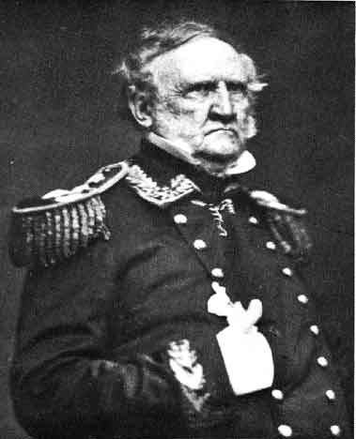
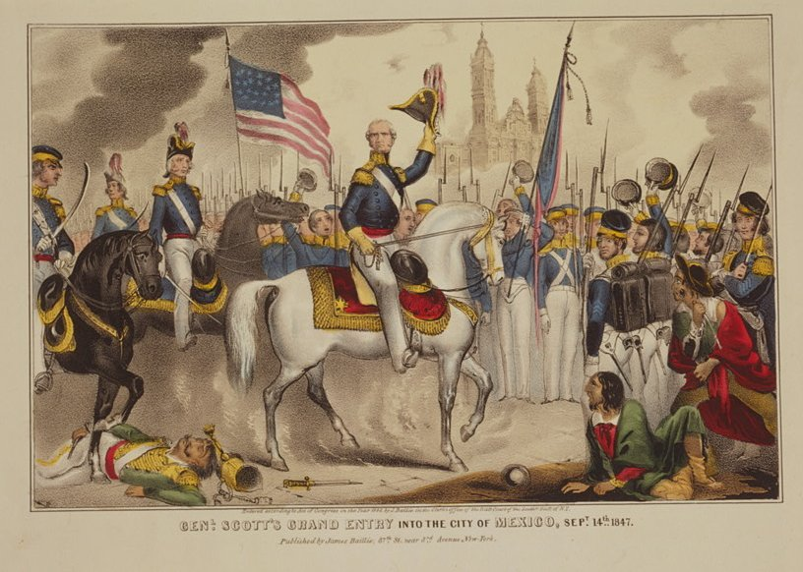

Slide 32
The Treaty of Guadalupe Hidalgo
Mexico will surrender after some resistance
The Treaty of Guadalupe Hidalgo
  Established the Rio Grande as the new border
  Ceded New Mexico, California to America
  America would offer fifteen million dollars for the land

Slide 34
The Backlash
Many Abolitionists believed this was a war to expand slavery
  William Lloyd Garrison
  Henry David Thoreau “Civil Disobedience”
The Wilmot Proviso
  A bill that claimed no slavery shall exist in territories gained from Mexico
  Passed because Northerners outnumbered Southerners in the House
  Did not pass in Senate

Slide 35
The Election of 1848
Whigs nominate
  Zachary Taylor, General
Democrats nominate
  Lewis Cass
  Promoted idea of “popular sovereignty”
A new party is created
  Radical Democrats+Antislavery “Liberty” Party
  Free Soil Party
  Nominated Martin Van Buren

Slide 36
Taylor Wins
Taylor promises to execute power without falling into Party Lines
Taylor wins
  Wins 8/15 Slave States
  Wins 7/15 Free States
Taylor elected without Slavery determining the outcome

Slide 37
The Gold Rush
Gold is discovered in California
  Sutter’s Mill
In 1849, over 300,000 people had moved to strike it rich
California soon would petition for statehood
Free or Slave?
  Taylor decided that California should decide for itself
  This would avoid Congressional disputes

Slide 42
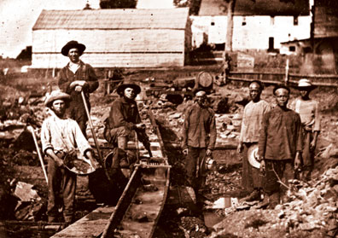

Slide 43
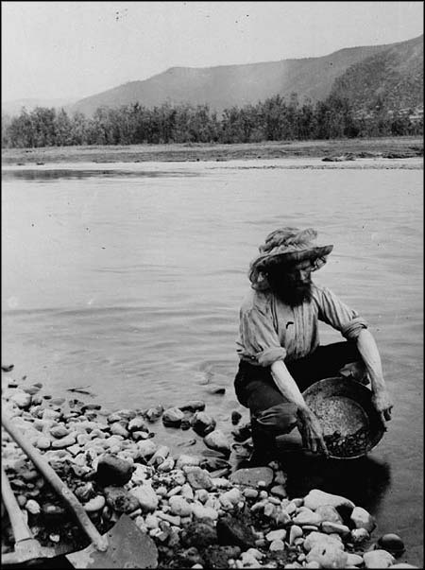

Slide 44
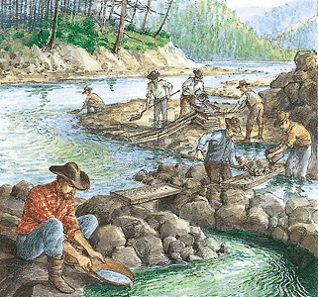

Slide 45
California Will Be Free
Californians decide on freedom
Southern States were outraged
  Taylor was a slave owner, many believed he would support slavery
  Taylor was more committed to keeping peace, not promoting an agenda
  Southerners see the balance of free/slave states being unfair

Slide 46
The Compromise of 1850
Henry Clay’s last, and greatest, achievement
Congress was hotly divided
Clay proposed:
  California should be brought into the Union as a Free State
  The rest of the Mexican Cession (New Mexico/Utah) would be annexed as states with no law against slavery
    Southerners could venture there with their slaves

Slide 47
Why It Passed
Northerners saw slavery as useless in the Southwest
  Too hot, not suited for successful farming
President Taylor insisted on his original plans
  Dies suddenly in 1850
  Makes V.P. Millard Fillmore the President
  Fillmore steps aside and lets Congress decide

Slide 48
Why It Passed
Many feared that Free States would battle Slave States if the deal wasn’t agreed upon
  Civil War seemed eminent
The Country celebrates its passing

Slide 49
